Slide 1
Lesson 6: What does our school network look like?
Year 3 – Computing systems and networks – Connecting computers
Notes:
Last updated: 31-07-24

Slide 2
Lesson 6: What does our school network look like?
Objectives
To recognise the physical components of a network
I can identify how devices in a network are connected together
I can identify networked devices around me
I can identify the benefits of computer networks

Slide 3

Switch
Introduction
A device that enables multiple devices on a network to be connected together
Notes:
Image source: https://pixabay.com/vectors/computer-hub-network-server-switch-159835/

Slide 4

Server
Introduction
A computer that manages the network and stores files
Notes:
Image source: https://pixabay.com/vectors/computer-database-network-server-156948/

Slide 5

Wireless access point
Introduction
A device connected to a wired network, which sends and receives wireless signals for devices with Wi-Fi connectivity
Notes:
Image source: https://pixabay.com/vectors/router-wifi-wireless-connector-23240/

Slide 6
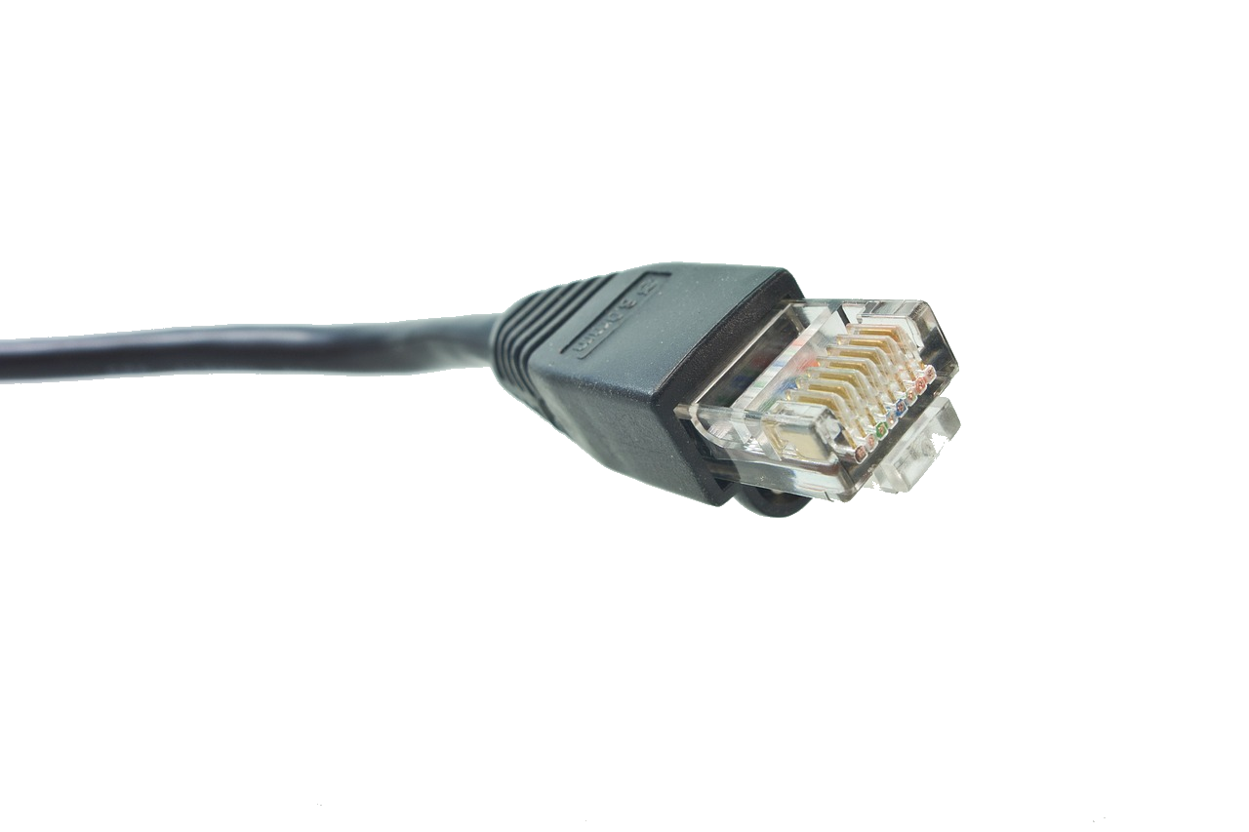

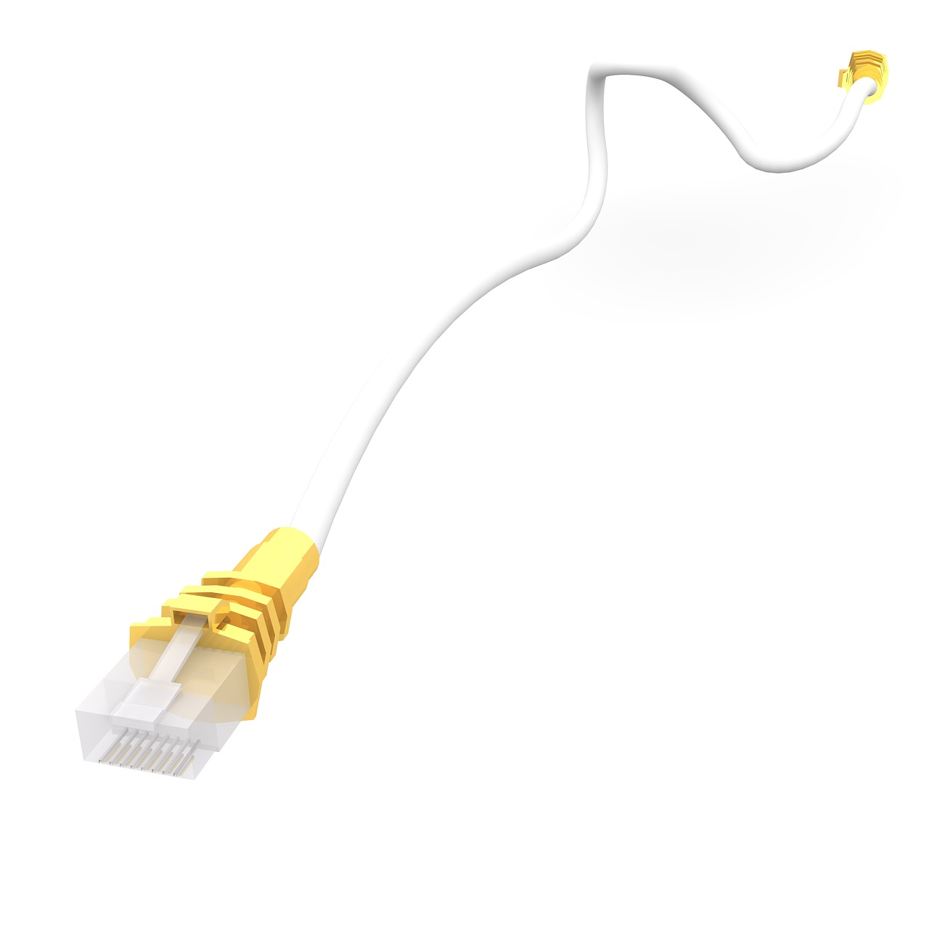
Other network components
Introduction
Network cables: wires used to connect wired devices to the network
Network sockets: allow network cables to be connected to the network
Notes:
Image sources:
https://pixabay.com/photos/network-cables-rj-plug-patch-cable-499798/
https://pixabay.com/illustrations/network-cable-ethernet-plug-1027309/
https://freesvg.org/network-socket

Slide 7
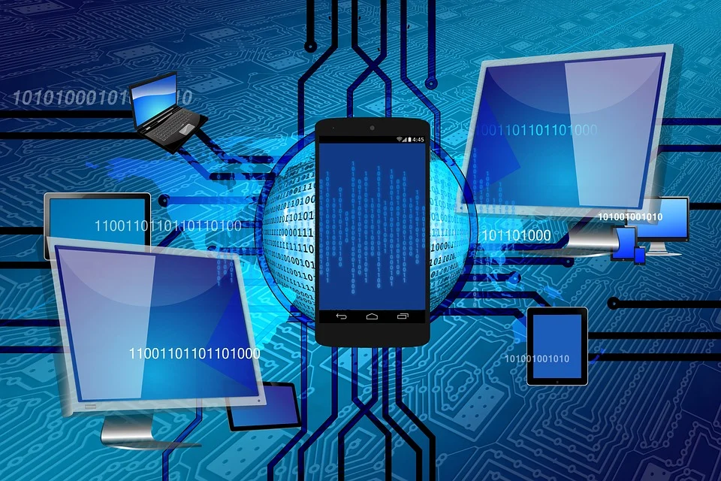
Benefits of a computer network
Activity 1
What kind of tasks does the school computer network let learners and staff members do?
Why is it useful for more than one person to be able to access information in school?
Notes:
Image source: https://pixabay.com/illustrations/binary-one-cyborg-cybernetics-1536651/

Slide 8

Who looks after the school network?
Activity 2
Our school IT technician looks after our school network
They are responsible for installing, ordering and maintaining software and hardware
Our IT technician provides technical support to teachers and pupils
Notes:
Image source: https://pixabay.com/photos/pc-hardware-man-personal-computer-5737958/

Slide 9

School network tour
Activity 2
You will be creating a map of your school network, so you need to know where network devices are located.
Which devices can you spot in the classroom?
Which ones can you see in corridors?
Which ones are in other rooms?
Notes:
Image source: https://pixabay.com/illustrations/binoculars-search-see-to-find-1026425/

Slide 10

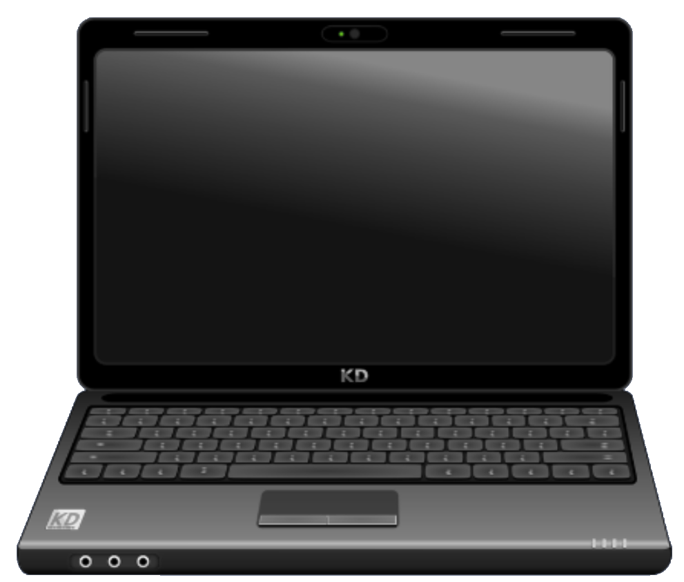
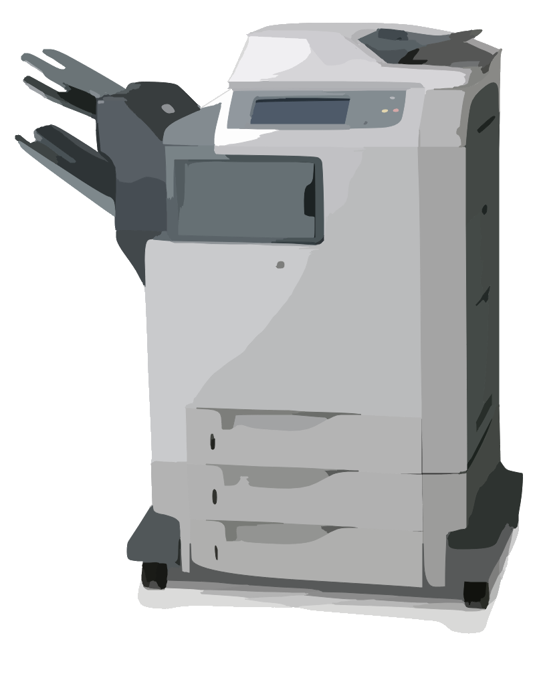

Mapping a network
Activity 3
Tablet computers
Wired connection
Wireless connection
Wireless access point
Switch
Laptop computer
Desktop computers
Printer
Server
Notes:
Image sources:
https://pixabay.com/vectors/computer-hub-network-server-switch-159835/
https://pixabay.com/vectors/copier-scanner-printer-office-42612/
https://pixabay.com/vectors/computer-database-network-server-156948/
https://pixabay.com/vectors/computer-desktop-pc-workstation-1295529/
https://pixabay.com/vectors/router-wifi-wireless-connector-23240/
https://pixabay.com/vectors/laptop-notebook-computer-black-158648/
https://pixabay.com/photos/ipad-tab-tablet-3d-2462599/

Slide 11
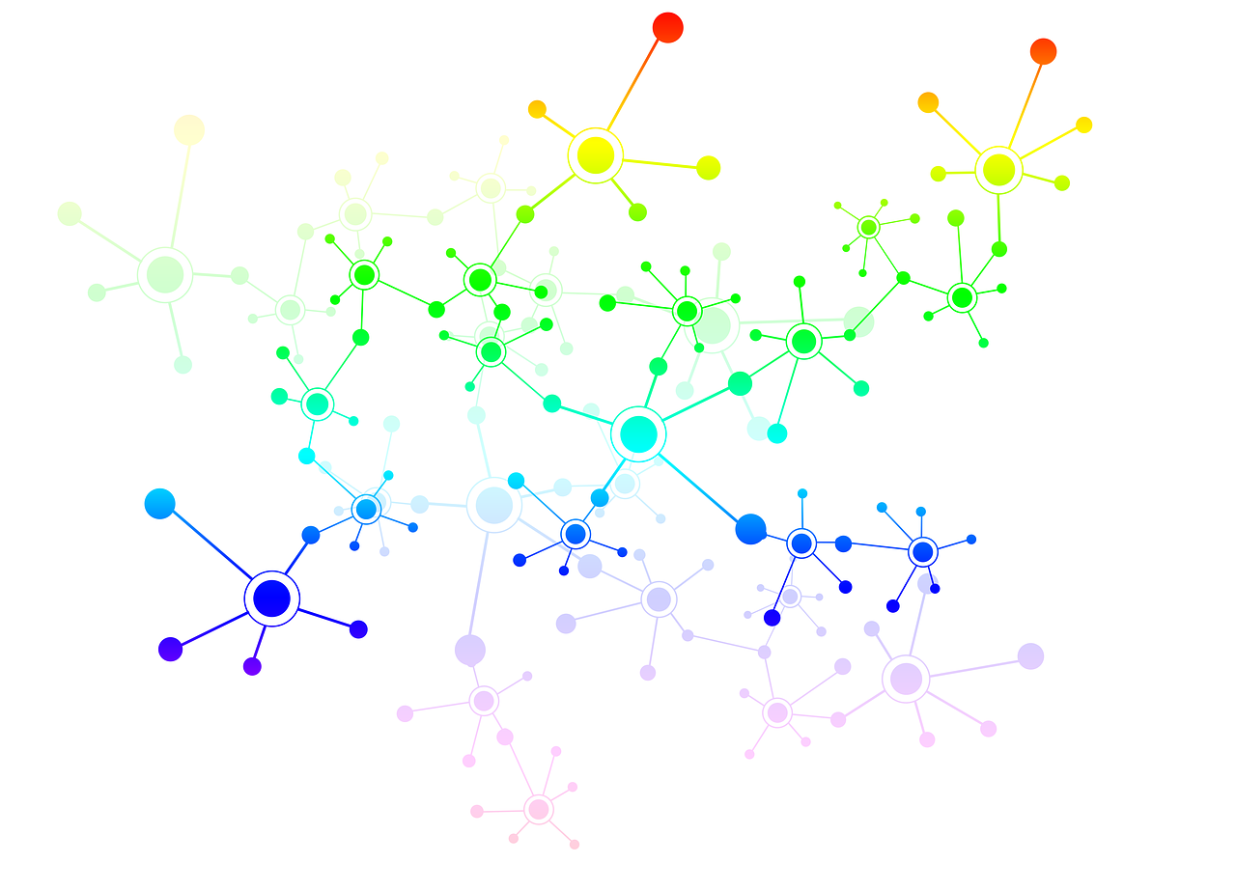
Networks
Plenary
Computers connected to other computers creates a network.
Networks let us...
Notes:
Image source: https://pixabay.com/illustrations/network-social-social-networks-1911678/

Slide 12
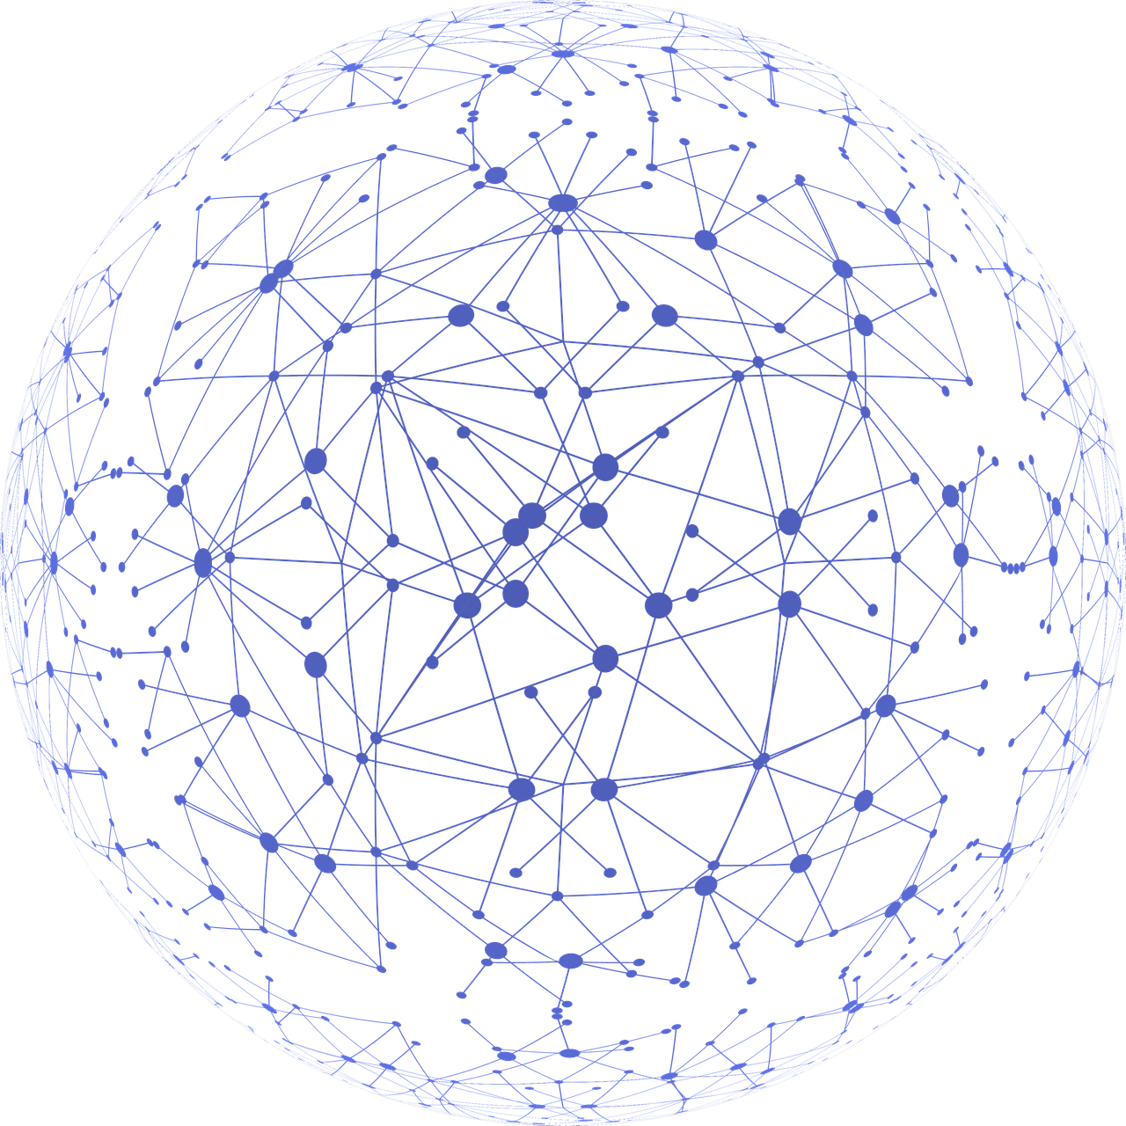
Internet
Plenary
Connecting networks together makes the internet.
Notes:
Image source: https://pixabay.com/illustrations/network-connections-communication-3537400/

Slide 13

How confident are you? (1–3)
Assessment
I can identify how devices in a network are connected together
I can identify networked devices around me
I can identify the benefits of computer networks
3 – Very confident
2 – Unsure
1 – Not confident
Notes:
Image source: https://pixabay.com/vectors/thumb-up-hand-like-confirm-go-top-307176/

Slide 14
This lesson
Summary
In this lesson, you…
Explored the computer networks in your school and considered the benefits of having a computer network

Slide 15
Attribution
This resource was created by Raspberry Pi Foundation and updated by STEM Learning for the National Centre for Computing Education.
The contents of this resource are available for use under the Open Government License (OGL v3) meaning you can copy, adapt, distribute and publish the information. You must acknowledge the source of the Information in your product or application, by attributing Raspberry Pi Foundation and STEM Learning as stated here, and are asked to provide a link to the OGL v3.
The original version can be made available on request via info@teachcomputing.org

