Slide 1

Use the question words to create your own questions about the images

Slide 2
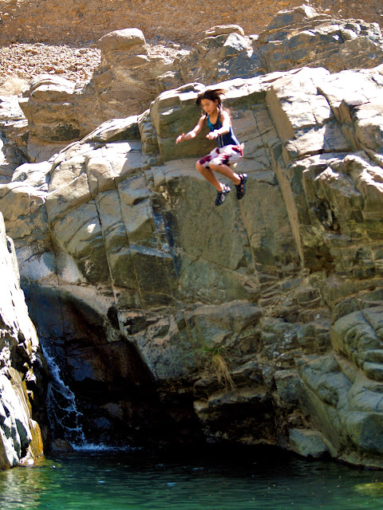
Where?
Who?
What?
Why?
When?

Slide 3

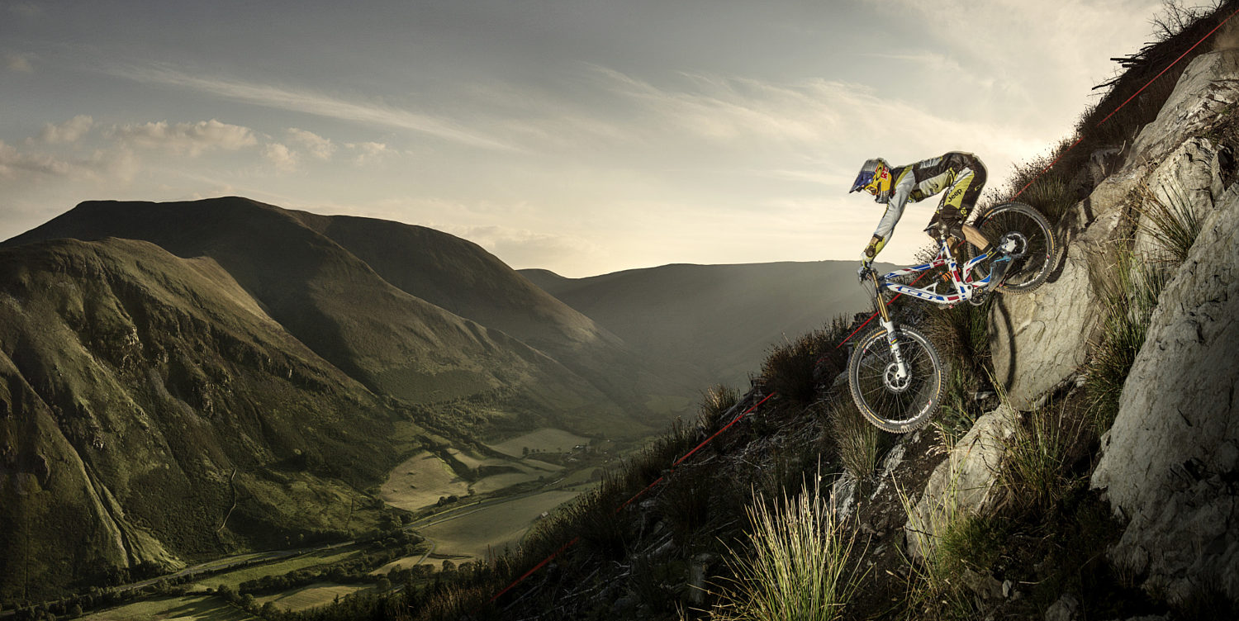

Where?
What?
Why?

Slide 4

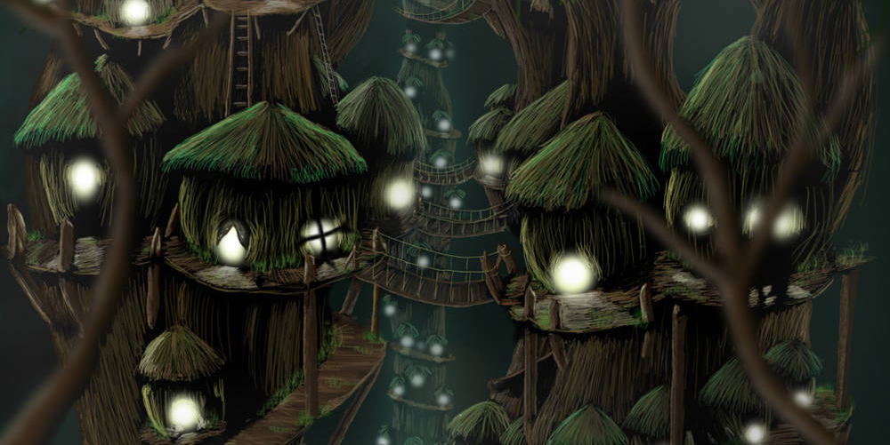



Where?

